Slide 1
Curve Fitting

Slide 2
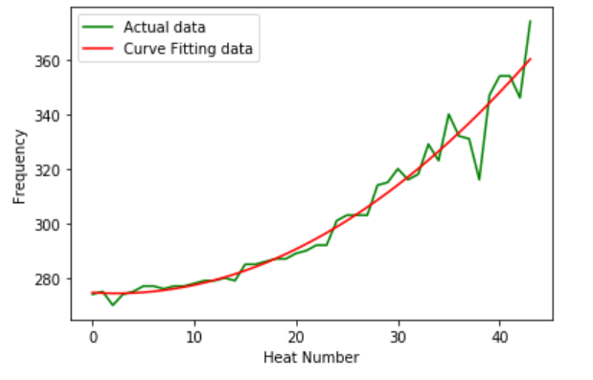
2nd degree Polynomial fitting for Frequency
Quadratic function fits well for Frequency

Slide 3
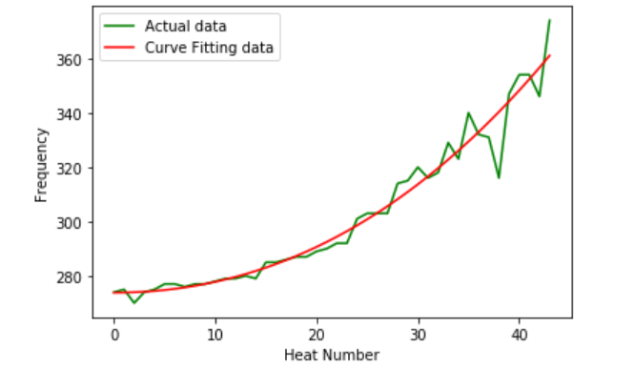
3rd degree Polynomial fitting for Frequency
Cubic function also fits well for Frequency

Slide 4
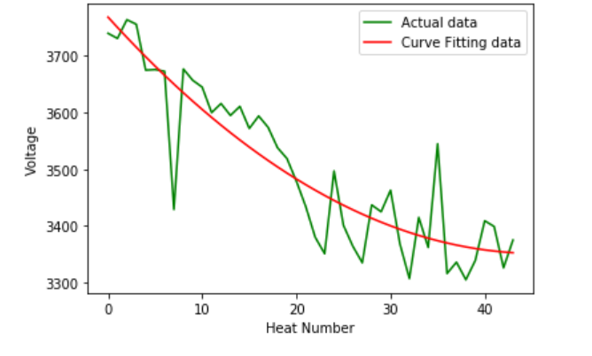
2nd degree Polynomial fitting for Voltage
Quadratic function fits well for Voltage

Slide 5
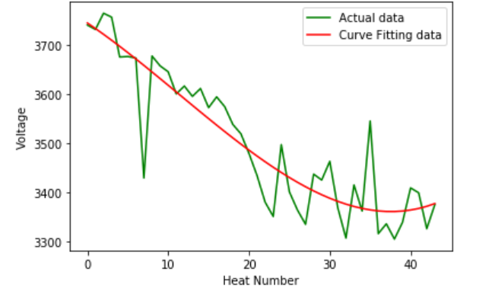
3rd degree Polynomial fitting for Voltage
Cubic function fits well for Voltage
However, we cannot use inverted version of this graph for refractory lining because we know that refractory lining is a strictly decreasing function

Slide 6
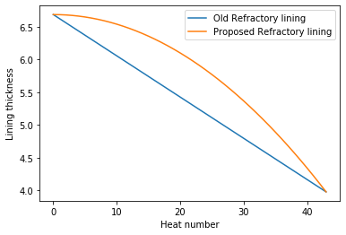
New Refractory lining
We have seen that the quadratic function fits well for both Frequency and Voltage
Since the refractory lining is strictly decreasing, we can use quadratic interpolation for the lining (inverted parabola)

Slide 7
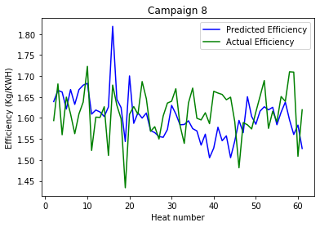
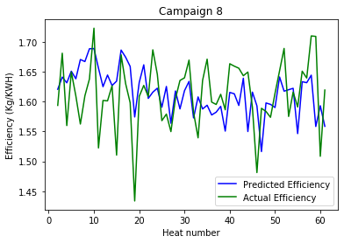
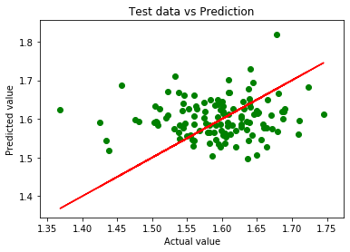
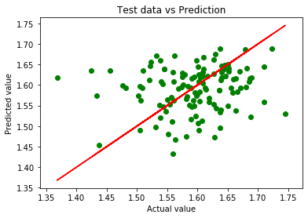
Efficiency prediction with new refractory lining
With linear interpolation
With quadratic interpolation
Test NMSE : campaign 8 : 147.3%
Test NMSE : campaign 8 : 114.2%

